Slide 1
NLP

Slide 2
Introduction to NLP
Background for NLP

Slide 3
Linguistic Knowledge
Constituents:
Children eat pizza.
They eat pizza.
My cousin’s neighbor’s children eat pizza.
Eat pizza!
Collocations:
Strong beer but *powerful beer
Big sister but *large sister
Stocks rise but ?stocks ascend
How to get this knowledge in the system:
Manual rules
Automatically acquired from large text collections (corpora)
Notes:
成分，部分。
搭配，词组。

Slide 4
Areas of Linguistics
Phonetics and phonology
the study of sounds
Morphology
the study of word components
Syntax
the study of sentence and phrase structure
Lexical semantics
the study of the meanings of words
Compositional semantics
how to combine words
Pragmatics
how to accomplish goals
Discourse conventions
how to deal with units larger than utterances

Slide 5
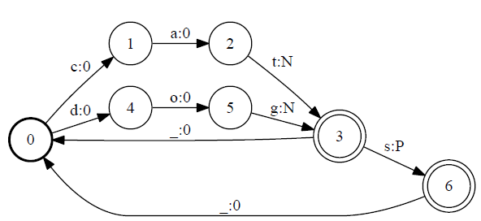
Finite-state Automata
Notes:
REPLACE THIS FIGURE!

Slide 6
Theoretical Computer Science
Automata
Deterministic and non-deterministic finite-state automata
Push-down automata
Grammars
Regular grammars
Context-free grammars
Context-sensitive grammars
Complexity
Algorithms
Dynamic programming

Slide 7
Artificial Intelligence
Logic
First-order logic
Agents
Speech acts
Search
Planning
Constraint satisfaction
Machine learning
Neural Networks
Reinforcement Learning

Slide 8
Mathematics and Statistics
Statistics
Probabilities
Statistical models
Hypothesis testing
Mathematics
Linear algebra (e.g., vectors)
Multivariate calculus (e.g., gradients)
Optimization
Numerical methods

Slide 9
Mathematical and Computational Tools
Language models
Estimation methods
Context-free grammars (CFG)
for trees
Hidden Markov Models (HMM)
for sequences
Conditional Random Fields (CRF)
Optimization

Slide 10
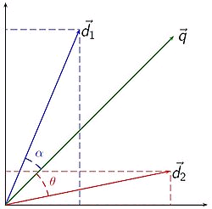
Statistical Techniques
Vector space representation for WSD
Noisy channel models for MT
Random walk methods for sentiment analysis

Slide 11
NLP

